Slide 1
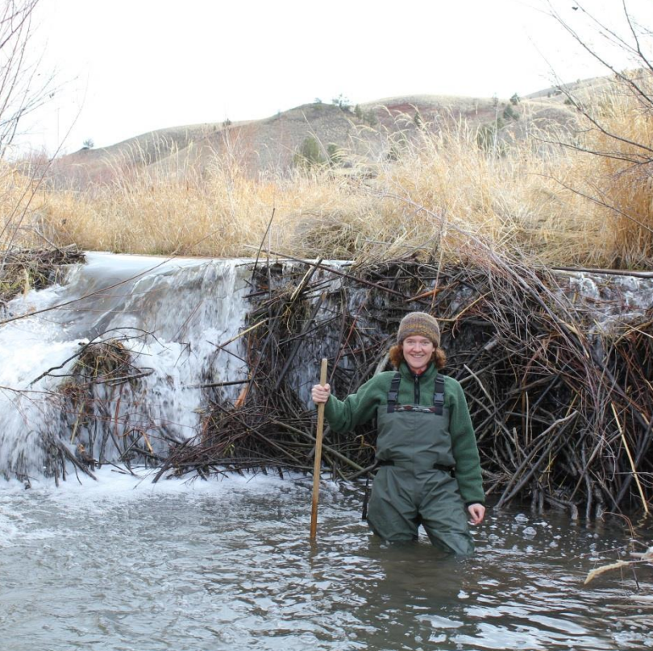
Low Tech, High Impact: Restoring Birch Creek with Beaver Dam Analogs
Group 6 – Conservation Perspective: Karina Reitz, Sophia Retten, Shaun Smith, and Trevor Heath
Image Source: TheBeaverRestorationGuidebook​

Slide 2
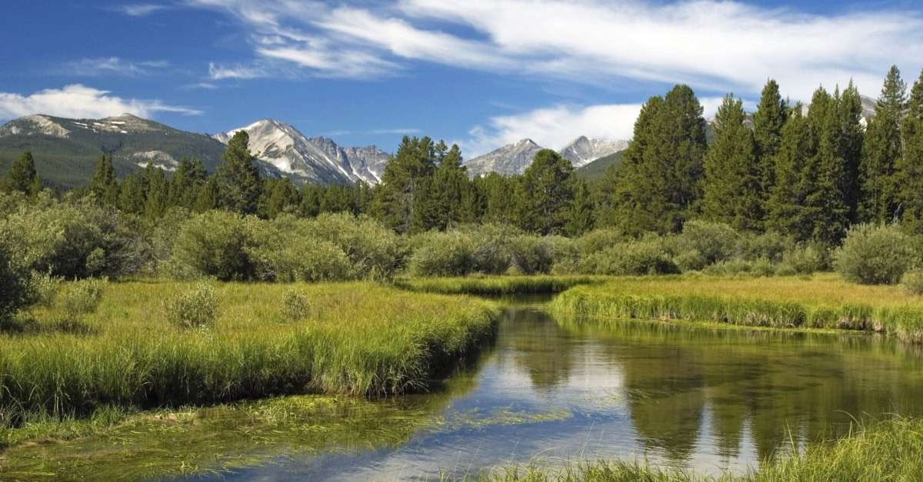

Pre-1860s
Healthy beaver populations facilitated the creation and maintenance of wetlands in the area
Image Source: Rick, Susie Graetz. From Visit Southwest Montana (https://southwestmt.com/specialfeatures/this-is-montana/valleys-and-rivers/big-hole-montanas-big-hole-country/).
Notes:
In the 1800s before the fur trade wiped out most of the beaver population in the area, the Big Hole historically had far more dammed wetlands than we see today. This allowed for abundant flora and fauna to cover the tributary landscapes.

Slide 3
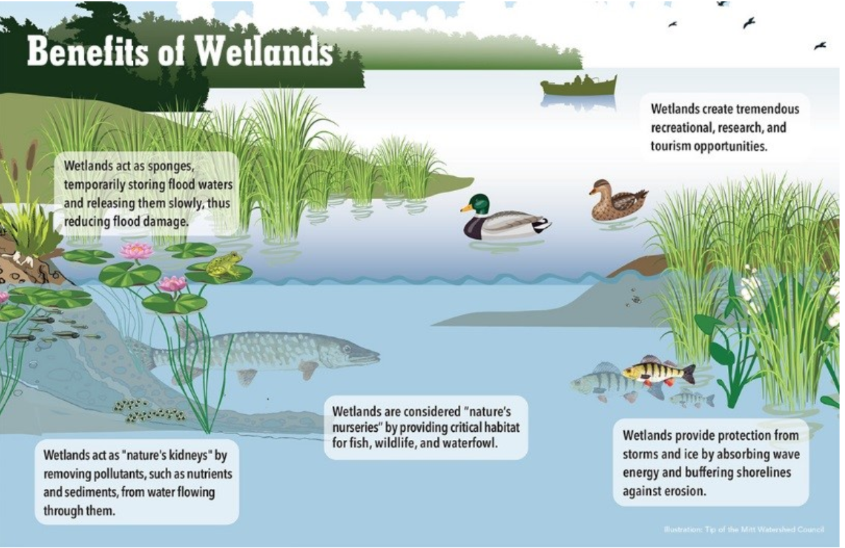
Wetlands Provide Vegetative Biodiversity
Image Source: Tipp of the Mitt Watershed Council (https://lakeconews.com/news/71725-lady-of-the-lake-what-s-in-a-wetland).
Notes:
These wetlands were crucial to keeping water storage higher in the mountains, which provided critical habitat for fish and wildlife, as well as alleviating stress from potential drought times in the later summer months. They can provide nursery habitats, protect against erosion, and provide new recreational opportunities amongst new wildlife!

Slide 4

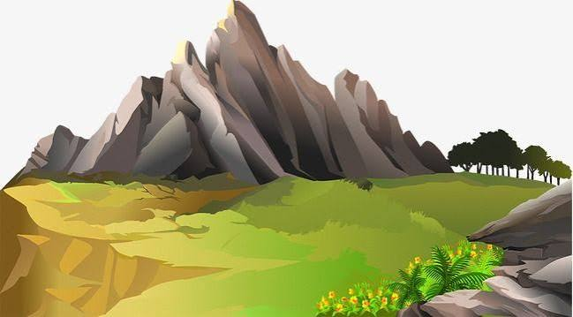


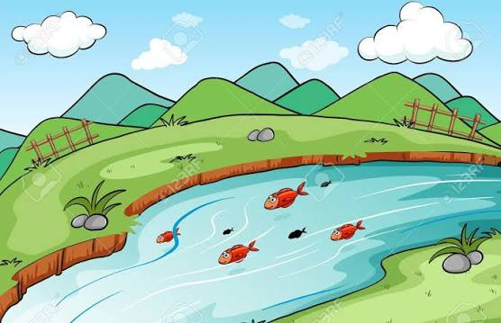
Wetlands Help Store Cool Groundwater for Future Use Downstream
Spring:
Summer:
Groundwater
Groundwater
Notes:
Wetlands soak up spring snowmelt that has accumulated on the high mountaintops like a sponge and raise the water table. This sponge keeps water buried and cool in a natural refrigerator until the hotter dry months of the summer where it can slowly seep back out and increase discharge while lowering temperatures.

Slide 5
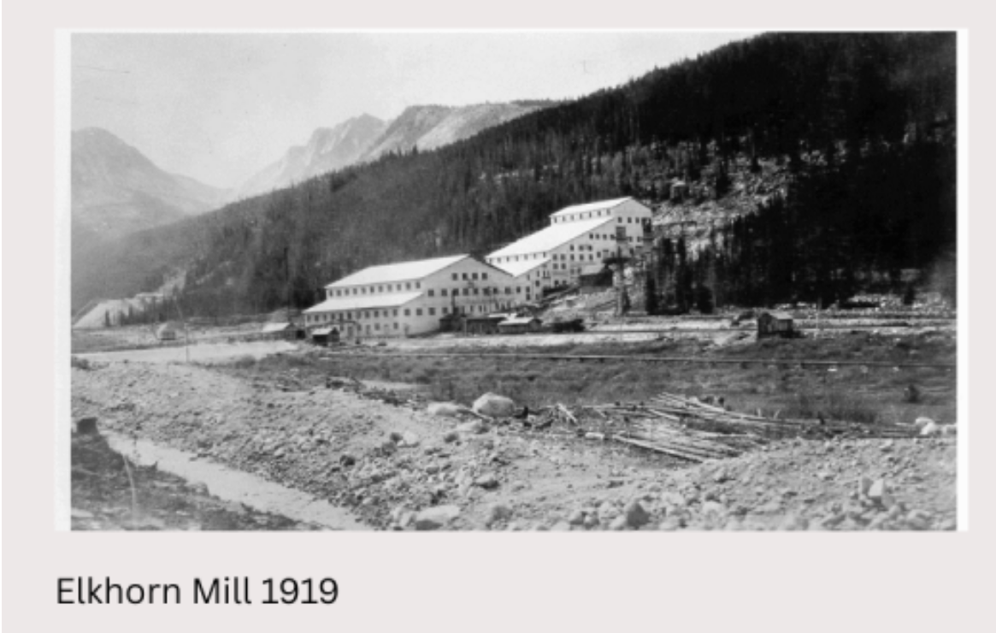
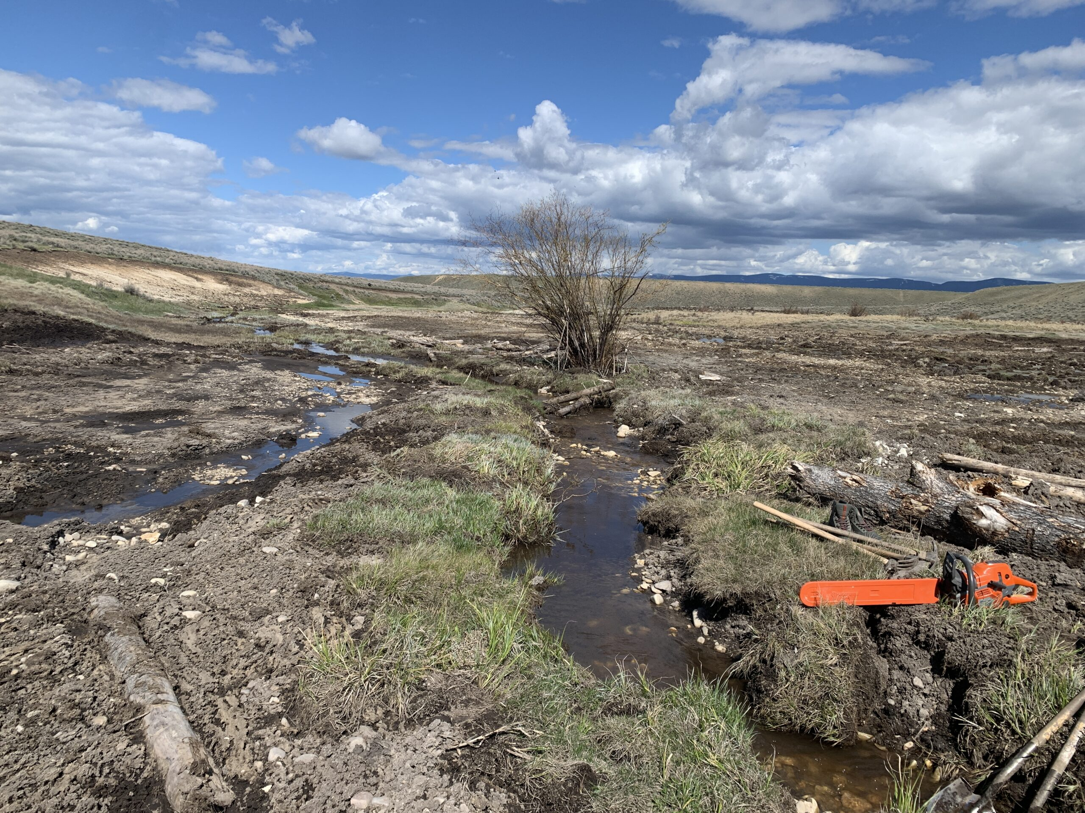
Mining and Climate Change Have Destroyed Wetlands and Lessened Groundwater Storage
Cause
Effect
Mining waste is dumped at streambanks
Land around streams is developed
Rising temperatures quicken the rate of chemical weathering
Stream width is constricted
There is less area for wetlands
Streams become incised, which limits the residence time of stream water
Photo: From Big Hole Watershed Committee (https://bhwc.org/project/elkhorn-mine/).
Photo: From Big Hole Watershed Committee (https://bhwc.org/project/smith-sage/).
Notes:
In addition to the loss of the beaver, Mining waste being dumped into rivers has constricted the width of rivers, making them more incised and quicker. Land development around streams has removed wetland area, and climate change has raised annual temperature which increases the rate of rock weathering in streams. This in turn increases discharge, but makes water leave the area more quickly without entering into the ground. All of these have caused discharge to increase, this allows water to quickly leave the mountains without entering into groundwater storage for later use.

Slide 6
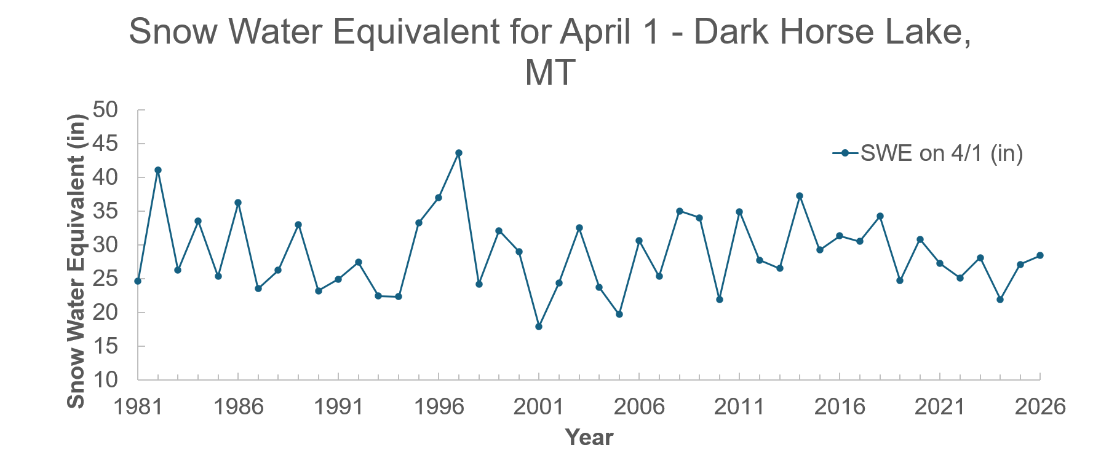
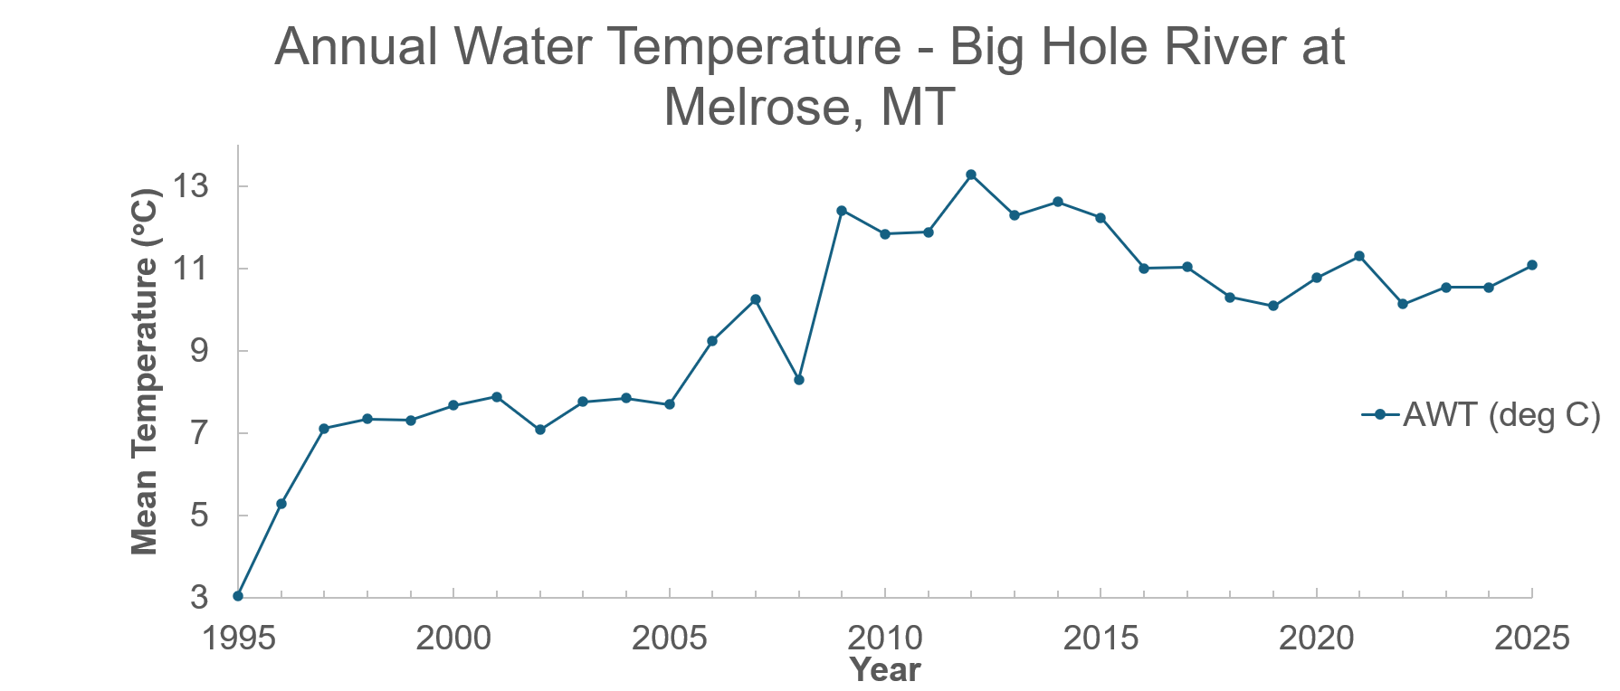
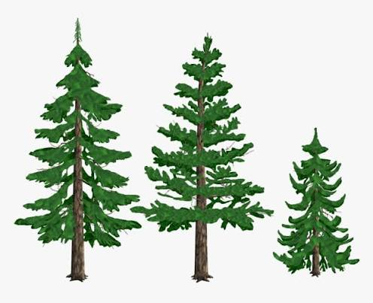

Presently, There is Less Vegetative Biodiversity in Big Hole Watershed Wetlands, and Arctic Grayling Populations Downstream are Threatened
Spring:
Summer:
Data file with plots: SMITH_BigHole_ClimateData.xlsx
Data file with plots: SMITH_BigHole_ClimateData.xlsx
Groundwater
Groundwater
Notes:
As we can see from these plots, snow water equivalent has been declining over time in the spring while in summer, the temperatures have been getting hotter. This combinations leads to increased frquency of drought years. This means the presence of wetlands are now more crucial than ever to ensure that snowmelt is retained in spring underground to reappear during the continually extending summer months.

Slide 7
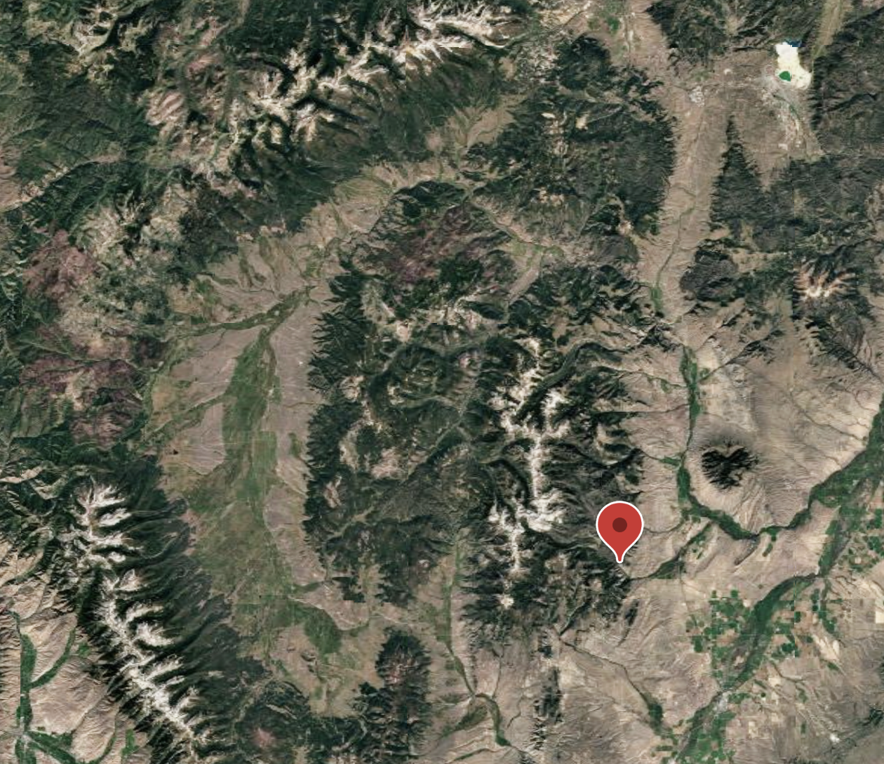
Birch Creek
Image Source: Google Earth capture, "Earth 450 Final Project"

Slide 8
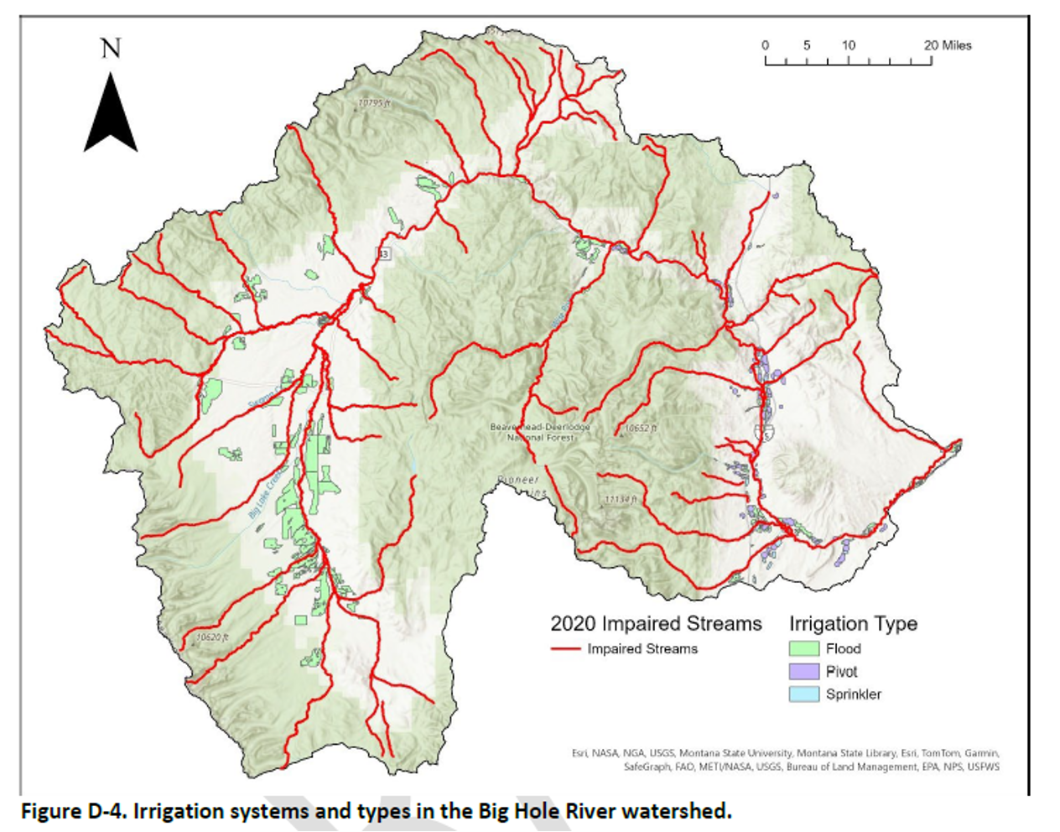
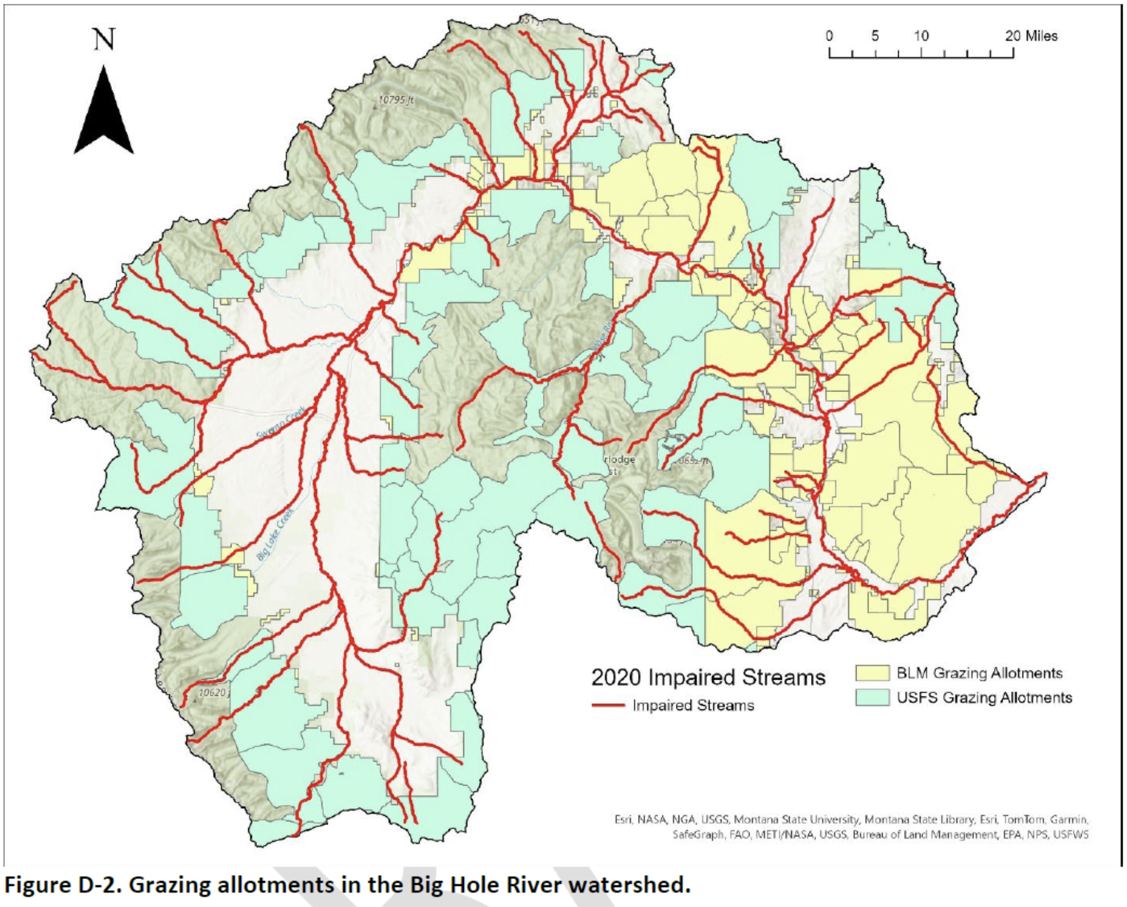
Big Hole Watershed Eastern Valley
Image Source: Maps of Land Use in the Big Hole Watershed, PowerPoint
Birch Creek
Notes:
Birch Creek, located in the eastern valley of the Big Hole Watershed, is surrounded by extensive grazing allotments and center-pivot irrigation, and is classified as an impaired stream because it does not meet U.S. EPA water quality standards.

Slide 9
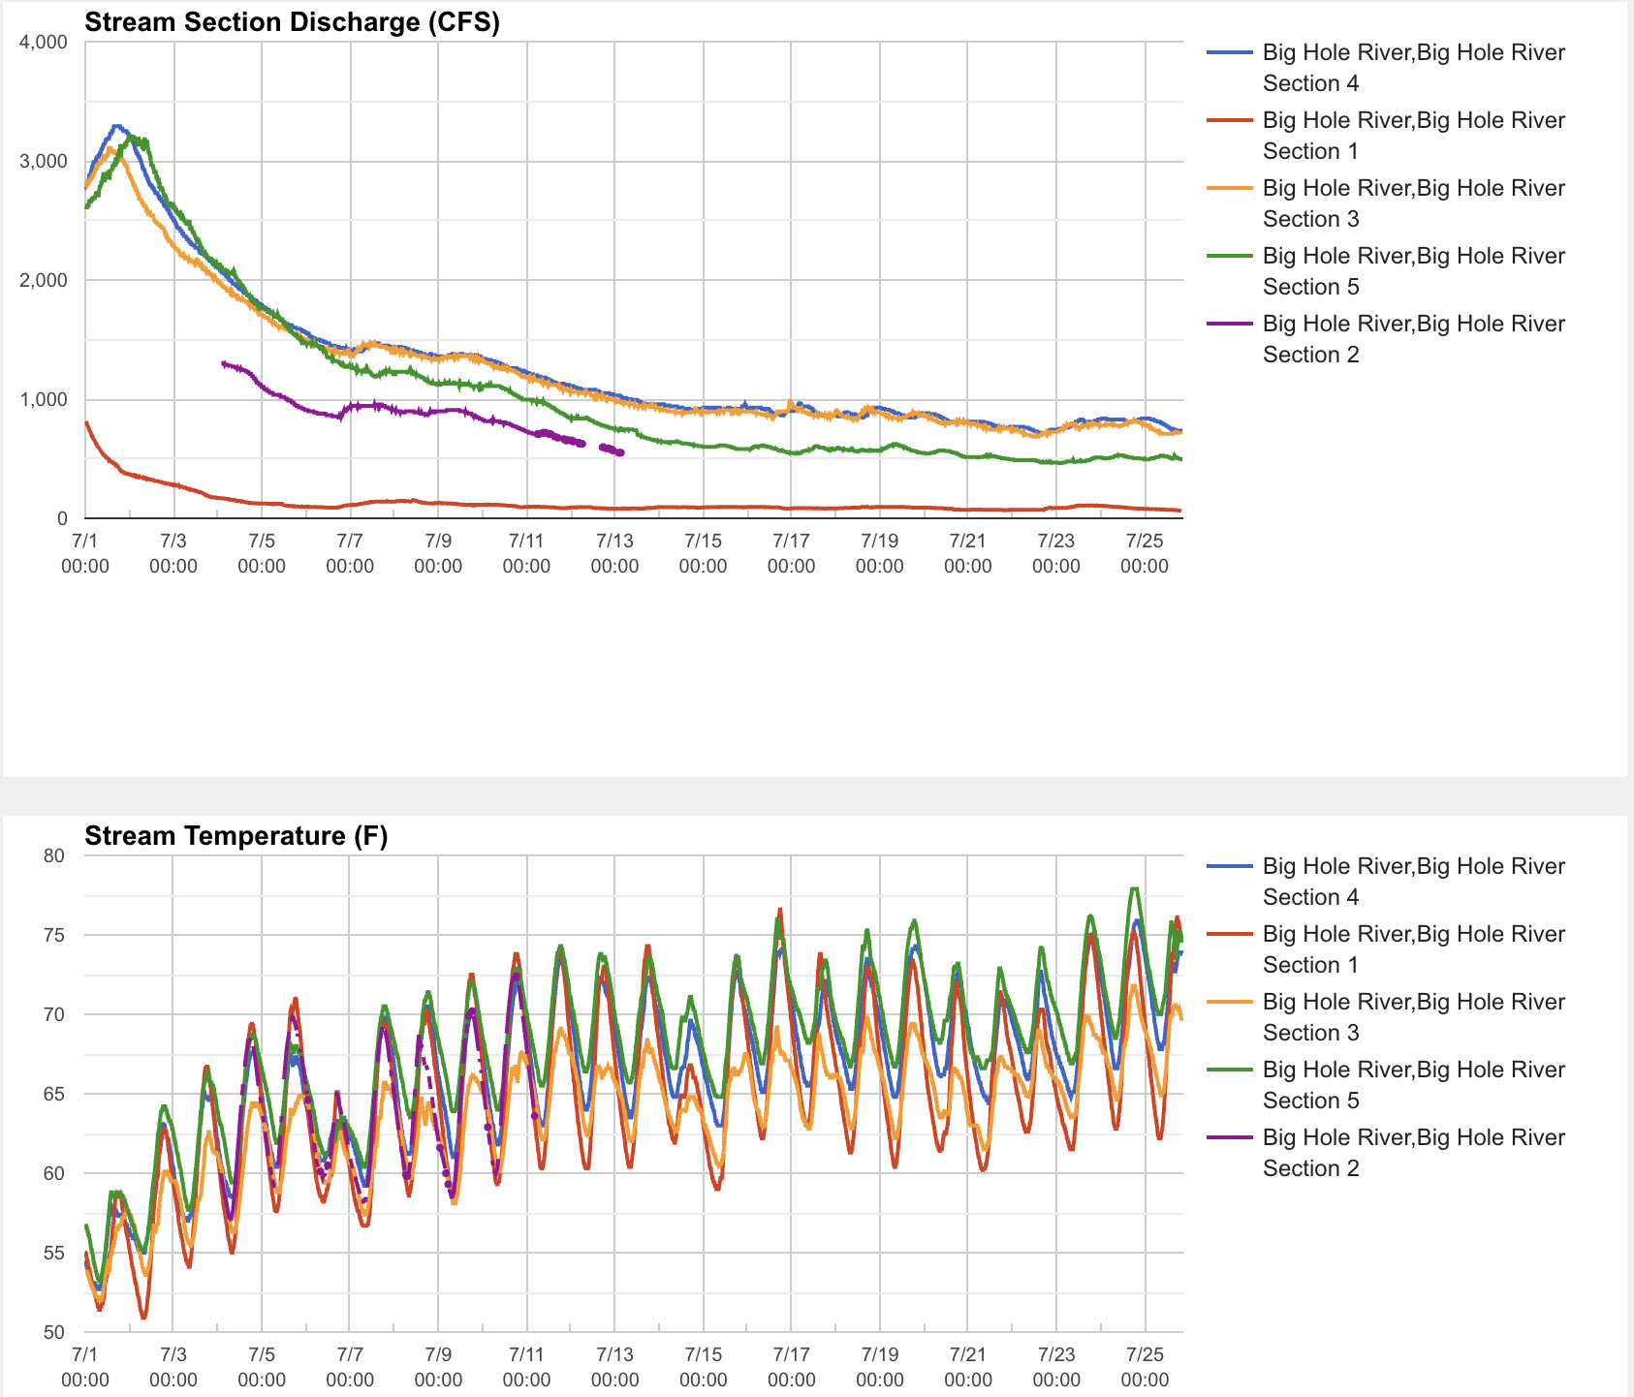
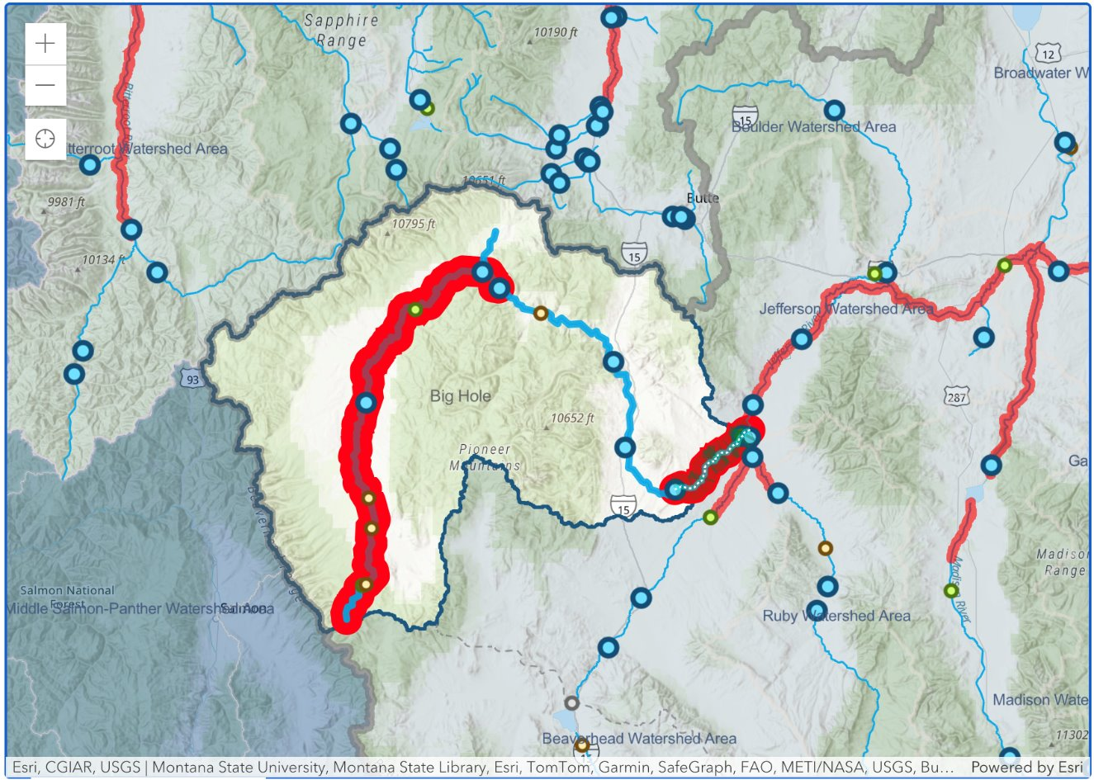
Big Hole River Sections 4 and 5
Image Data Source: Big Hole Watershed Section Restrictions, bhwc.org/riverconditions/
Plot Data Source: Big Hole Watershed Committee River Conditions, bhwc.org/riverconditions/
Birch Creek and Big Hole River Confluence
Notes:
The Big Hole Watershed is divided into five sections, with Birch Creek flowing through Section 4 before joining Section 5, where discharge has declined the most and stream temperatures are the highest. These trends are consistent with climate change, as reduced snowpack decreases streamflow, leading to warmer stream temperatures.

Slide 10
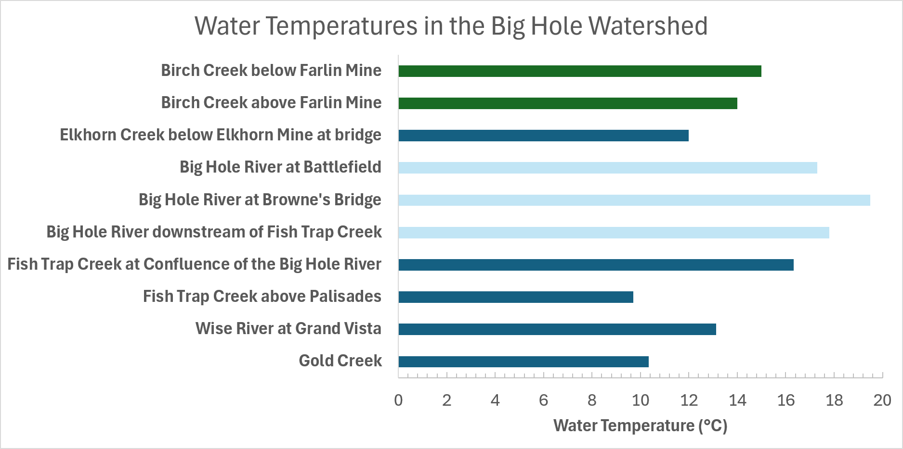
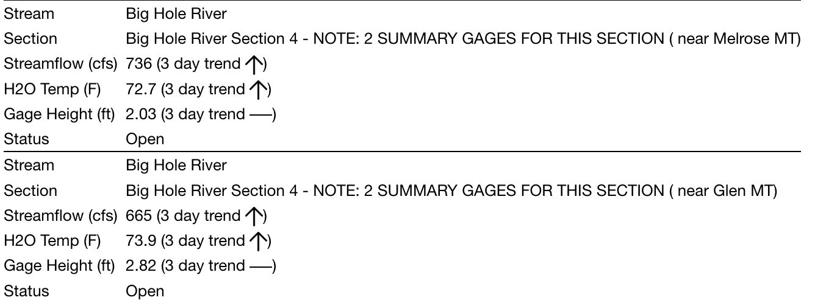
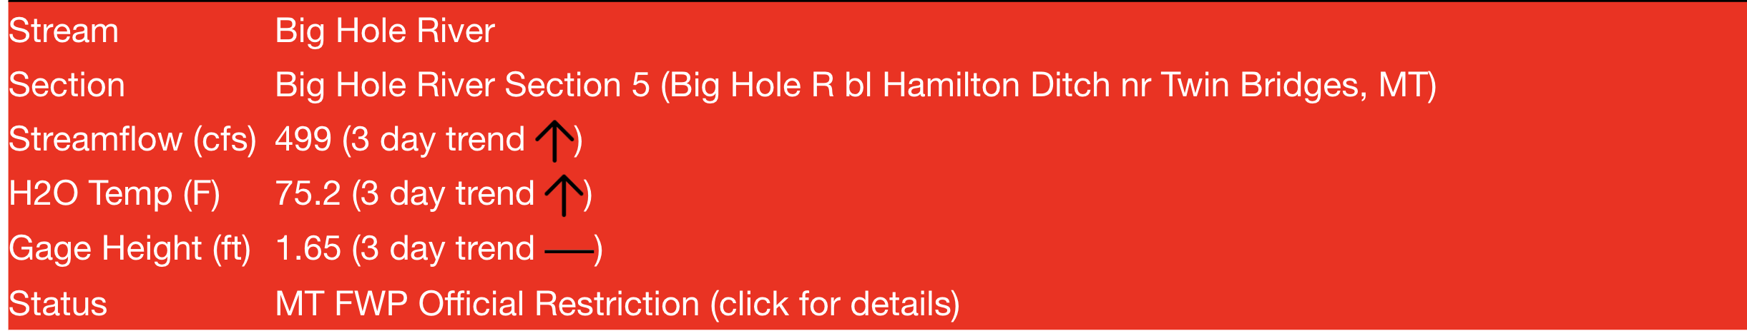
Birch Creek is the Warmest Creek Sampled
Birch Creek below Farlin Mine experiences high temperatures
Section 4 and 5 water temperatures above 70 ºF
Section five is currently under Hoot Owl Restrictions (prohibits angling 2pm to Midnight)
Data file with plots: Unit4_DataFileAnalyses.xlsx
Image Data Source: Big Hole Section Restrictions, bhwc.org/riverconditions/
Notes:
Stream temperature is a major concern, as Birch Creek recorded the warmest temperature of all sampled streams (15 °C on July 24, 2026), while Sections 4 and 5 reached 72–75 °F, temperatures that can stress Arctic Grayling. Because Birch Creek is a third-order stream, restoration should focus on its cooler first-order tributaries to help reduce downstream water temperatures.

Slide 11
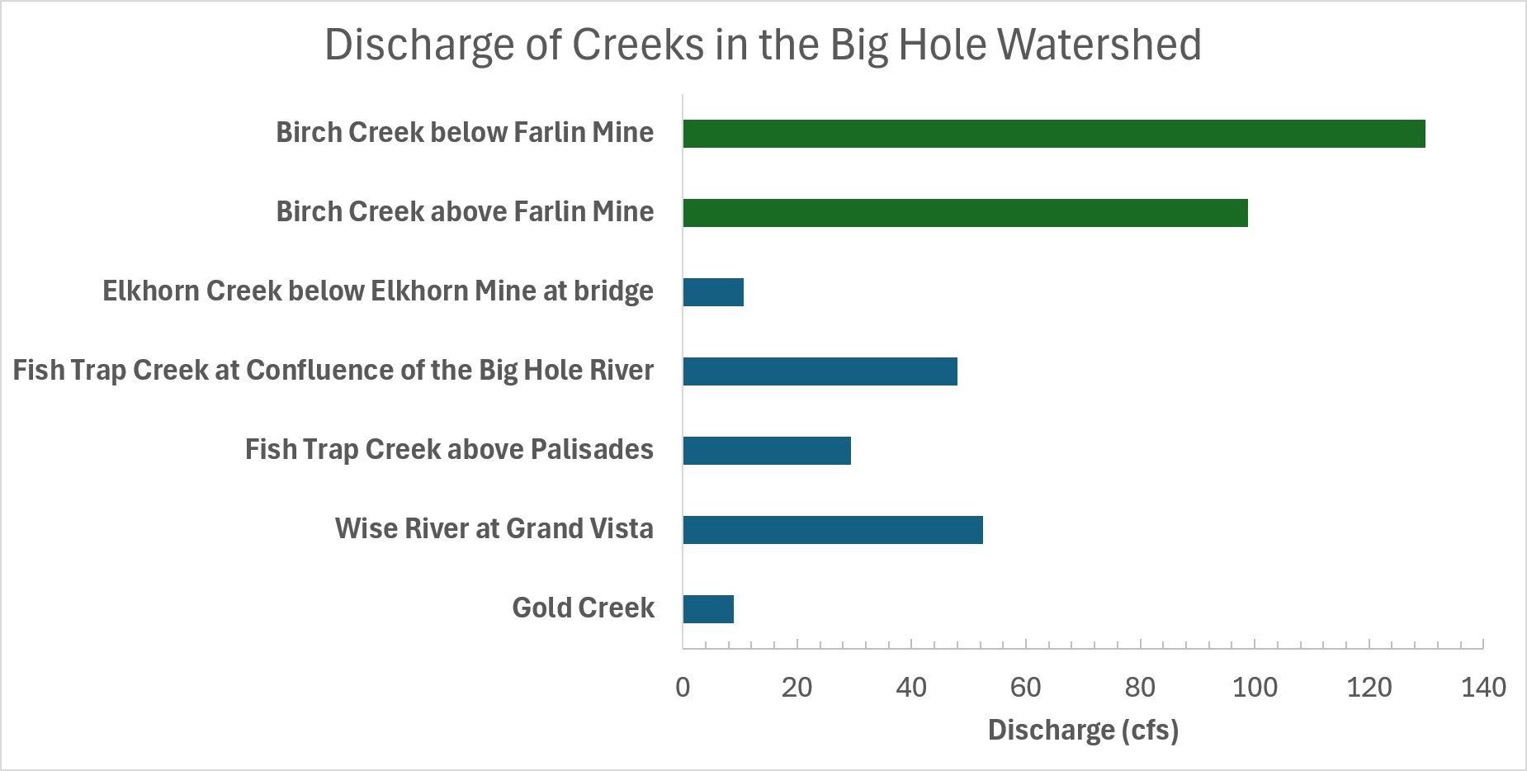
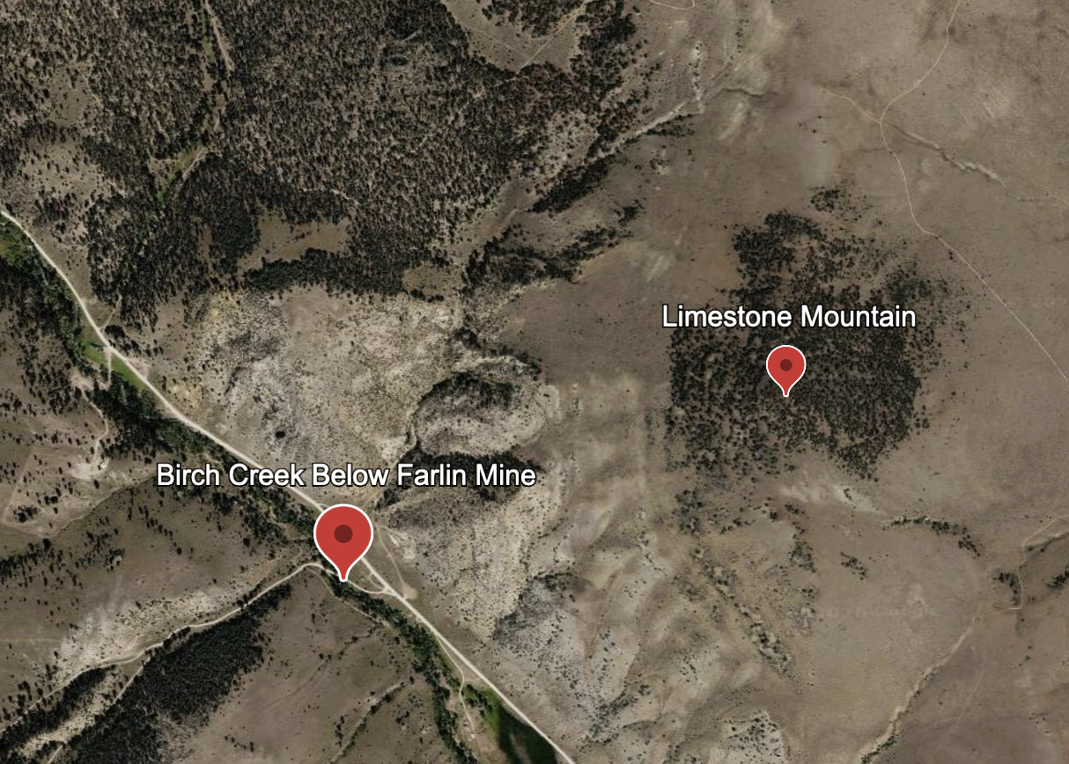
Birch Creek as an Ideal Pilot Location
Data file with plots: Unit4_DataFileAnalyses.xlsx
Image Source: Google Earth capture, "Earth 450 Final Project"
Birch Creek's high discharge and favorable geography make it a great pilot location for lowering temperatures in Big Hole River Zones 4 and 5, as well as:
Although it passes through an old mine site, the carbonate base of the mountain allows it to buffer against potentially harmful pH changes
The creek flows into Sections 4 and 5 of the Big Hole River, which are more sensitive to drought conditions
Birch Creek measured the highest discharge of all creeks sampled
Notes:
Birch Creek at Farlin Mine had the highest discharge of all our sampling sites, likely because snowmelt from the Pioneer Mountains supplies a strong spring streamflow. However, rapid runoff reduces groundwater recharge, limiting cool baseflow during summer, while the surrounding limestone buffers the stream against low pH from the historic mine site.

Slide 12
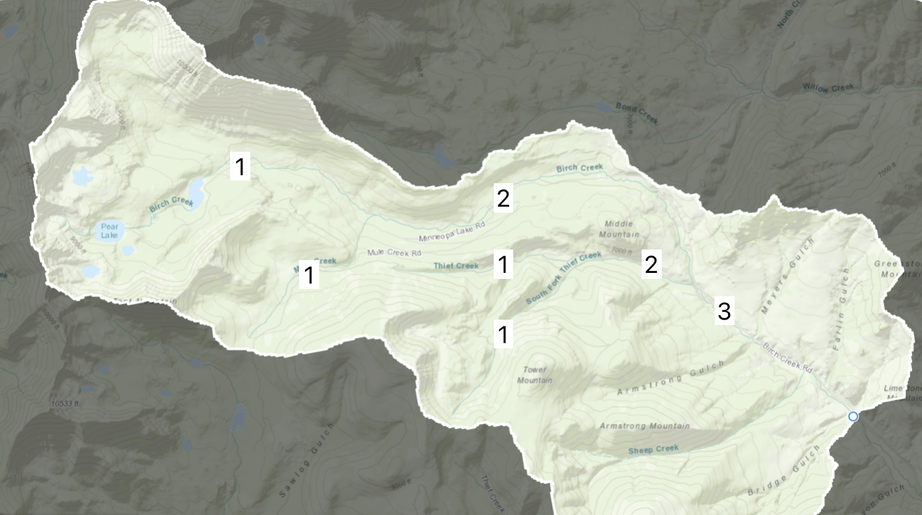
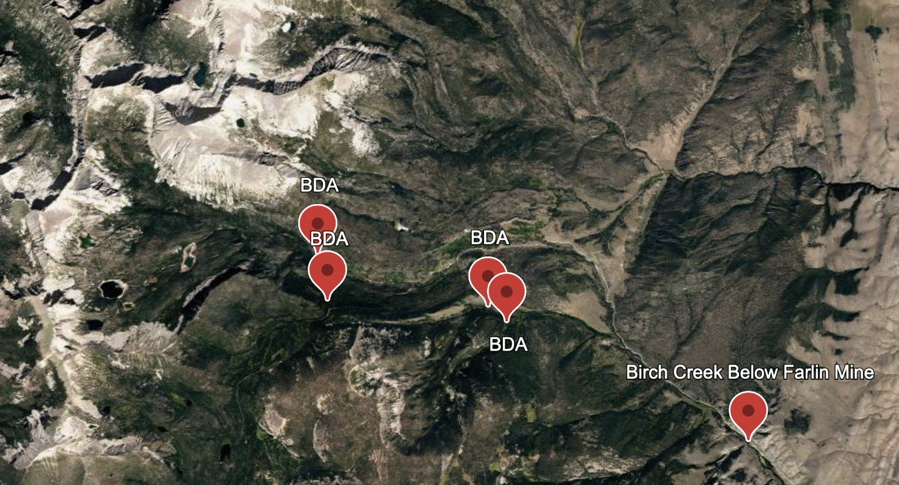
BDAs Will Cool and Stabilize Birch Creek
Image Data Source: Birch Creek Delineated Watershed, modelmywatershed.org
Image Source: Google Earth capture, "Earth 450 Final Project"
Our plan is to construct four beaver dam analogs in the first-order tributaries that flow into the third-order stream at the Birch Creek Below Farlin Mine sampling site; this will:
• Form wetlands at the dammed sites upstream
• Reduce speed and erosive power of flow downstream
• Increase water storage in the groundwater which can feed the Big Hole River colder water in summer
Notes:
For our project, we will construct four Beaver Dam Analogs in the first-order tributaries that flow into the third-order stream of Birch Creek. A BDA is a human-made structure that mimics a natural beaver dam to slow the flow of water while still allowing for the passage of fish. The reduced speed of the stream will allow for increased water storage in the groundwater, which can feed the Big River colder water in summer.

Slide 13
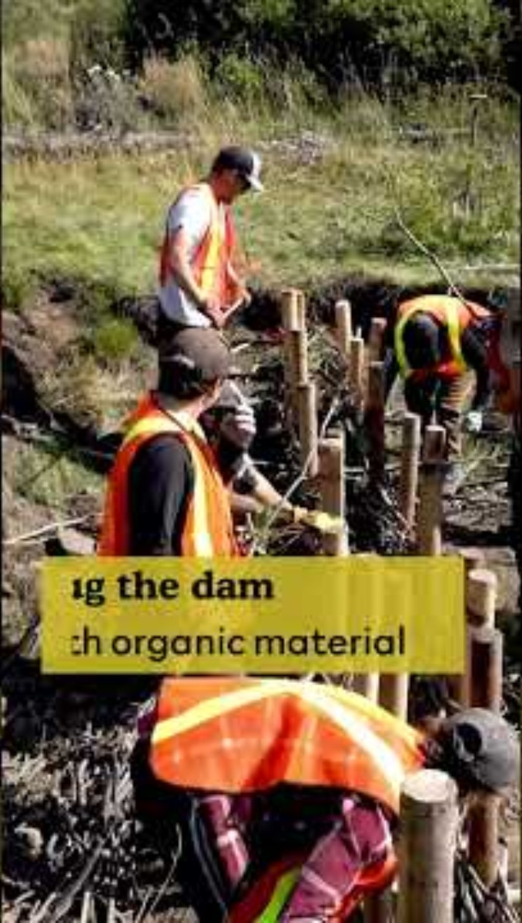
Wood Posts and Woven Willow Slow the Current
Wood (conifer) posts are drove into streambed to anchor the structure
Woven willow branches and a rock-reinforced base form a "leaky weir", which is permeable enough to slow flow without fully damming the creek or prevent fish from migration
Sediment and debris collect behind the structure, raising the streambed and reconnecting the floodplain
Video Source: Cows and Fish, YouTube (How to Install a Beaver Dam Analogue)
Notes:
Wood posts are anchored into the streambed to create a base for the structure. We would hope to use locally cut conifers as our posts to keep the landscape native. Other riparian Native plants, such as willow branches, are then woven in between the posts to create a "leaky weir". Natural sediment will collect behind the structure, reinforcing it and making it less permeable. Sometimes rocks are added at the base behind posts in faster-moving streams as reinforcement.

Slide 14
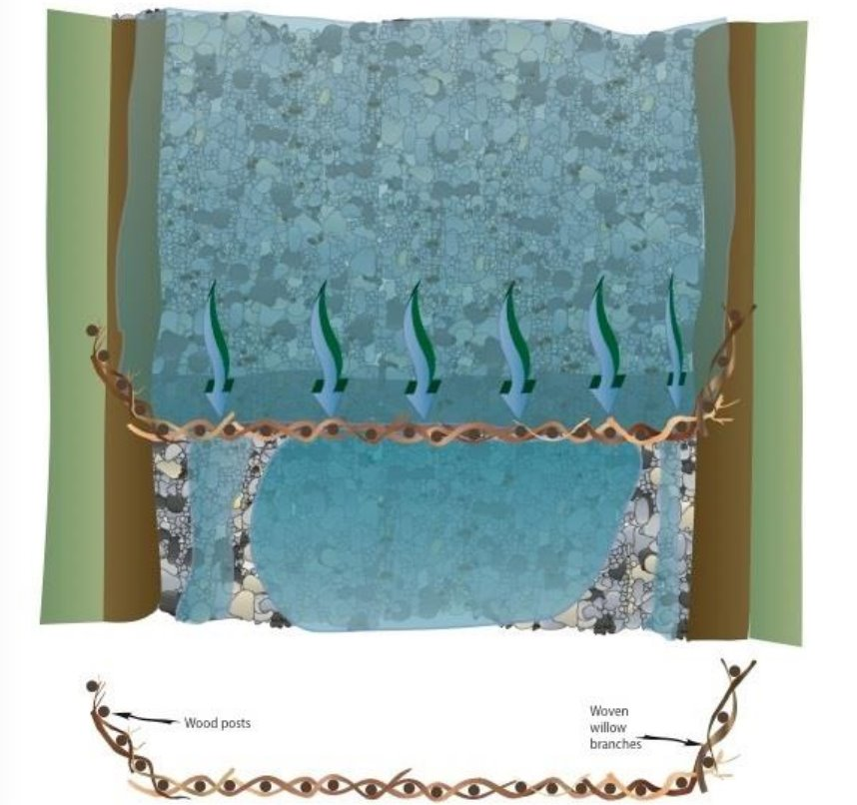
Construction and Project Logistics
Materials travel to the tributaries via Birch Creek Road and Thief Creek Road by truck
All proposed sites are within U.S. Forest Service boundaries, simplifying permitting compared to private land
Trucks haul materials to the roadside; final stretch to each site by wheelbarrow
Use hammers or handheld hydraulic presses to anchor posts
Image Source: Diagram of Starter Dam, TheBeaverRestorationGuidebook
Notes:
Beaver dam analogues will be constructed from wooden posts, native fill, and onsite angular granite, with materials transported by truck via Thief Creek, Mule Creek, and Birch Creek roads and carried the remaining distance by wheelbarrow. Because the sites are within U.S. Forest Service land and use locally sourced materials, construction logistics and transportation costs are minimized.

Slide 15
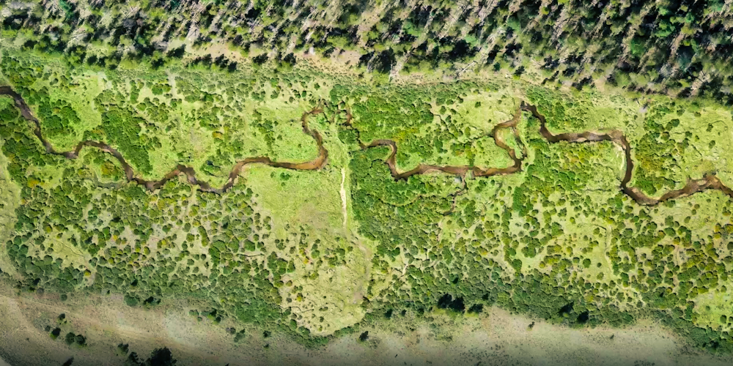
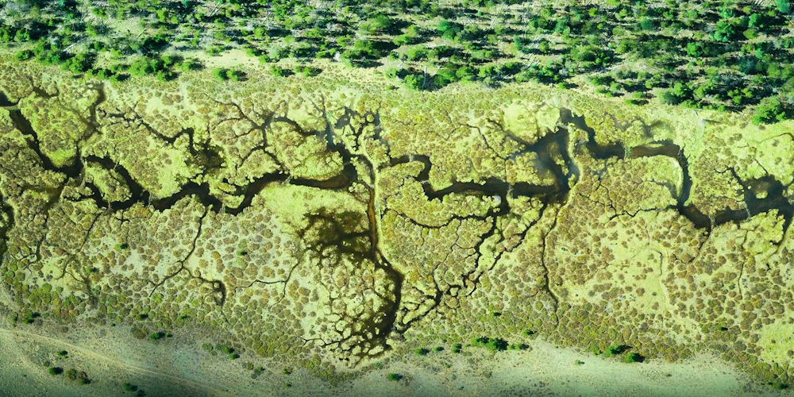
We're Restoring What Historic Land Use Removed
Benefits
Considerations
Recharges groundwater and raises the water table
Allows cooler stored groundwater water to enter Big Hole River during summer months
Restores wetland extent and boosts aquatic and avian biodiversity
Long-term success depends on beavers eventually taking over maintenance or continued manual upkeep
Could raise water temperatures within Birch Creek
Image(s) Source: Photo courtesy of Eco metrics Media, via National Forest Foundation (left, right)
Notes:
Our project aims to restore the Big Hole Watershed by recharging groundwater, raising the water table, increasing cool summer baseflow, and improving wetland and aquatic biodiversity. Although, beaver dam analogues require ongoing maintenance unless beavers take them over, and a slower streamflow could raise water temperatures within Birch Creek.

Slide 16
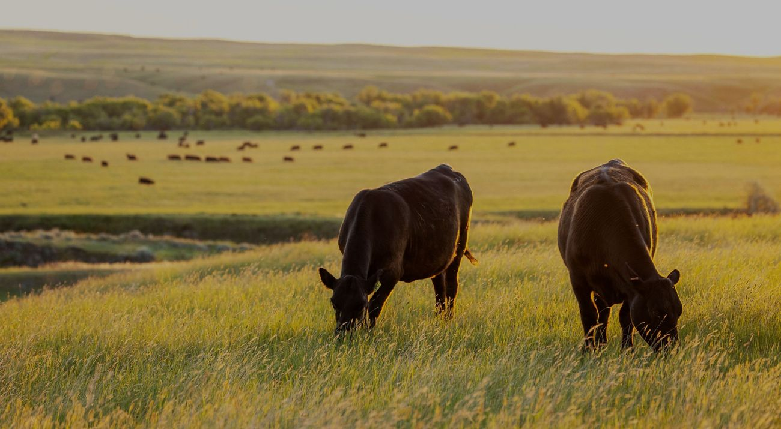
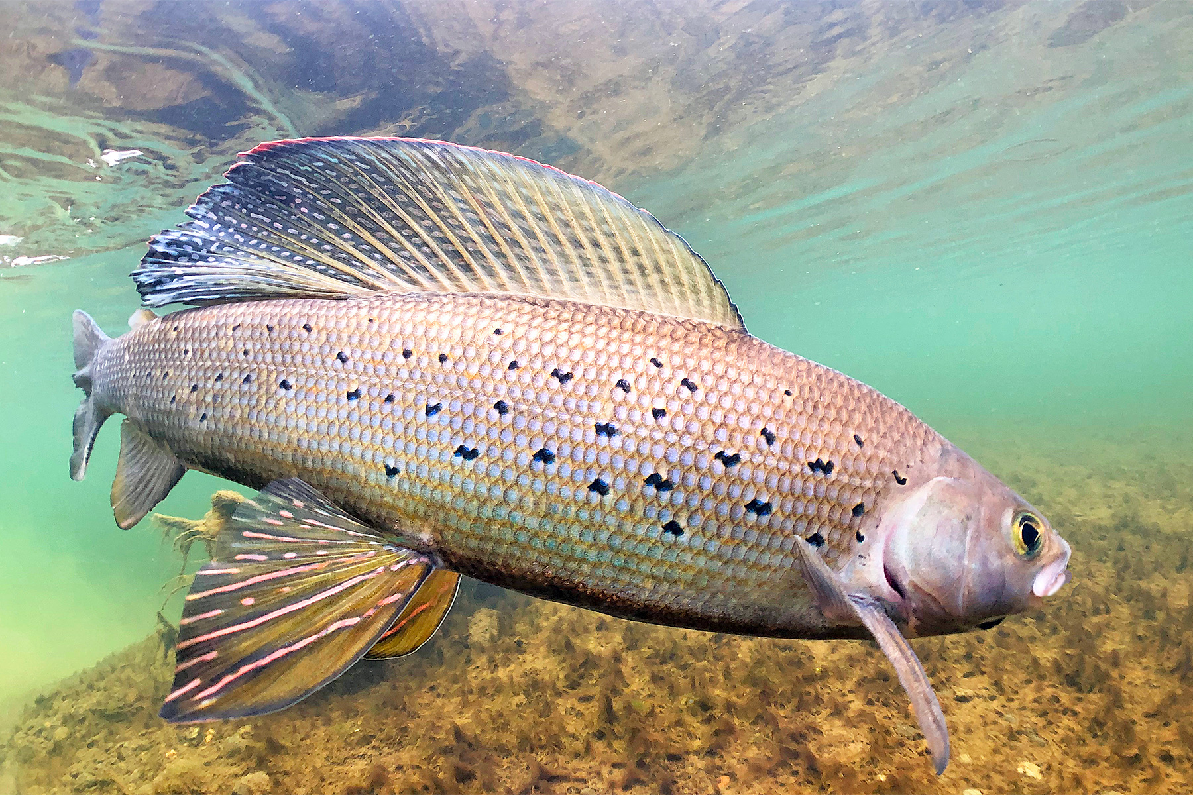
More Water, Later in the Season
Benefits for Ranchers
Benefits for Anglers/Recreationalists
Raises water table, which provides insurance against drought during summer months
Slower discharge grows more substantial wetland vegetation for grazing on public lands
Buffers temperature with cold water stored upstream, strengthening fish habitats
Creates winter holding pools for migrating adult/young fish who need slower moving streams for rest
Can reduce risk of Hoot Owl Restrictions or Total Closures
Image(s) Source: The Nature Conservatory (left), The Fly Shop (right)
Notes:
The dams would lead to more water, later in the season. Because of this, ranchers would benefit from increased insurance against droughts in the Eastern Valley, this is especially important in a region that uses mostly pivot irrigation instead of flooding irrigation, which won't store water. Public grazing allotments should also increase in vegetation around the wetland areas. Anglers would benefit as strengthed fish habitats will lead to less potential of river closings or restrictions on fishing during the summer months when demand for recreation is high.

Slide 17


BDA Strategy Diagram
Groundwater Storage
Summer Irrigation Potential
Decreases
Increases
BHR Summer Temperature
Stress on Fish Populations
Birch Creek BDAs
Stream Velocity
Wetland Coverage
Biodiversity
Notes:
To walk you through a strategy diagram: The introduction of BDAs in the Birch creek tributaries would decrease velocity downstream, which would let the land act as a sponge to increase groundwater storage to be released later in summer. This increases summer irrigation potential in the eastern valley as well as decreasing Big hole river temperatures by increasing discharge, which will cause less stress on fish populations. Lower stream velocity also allows for wetlands to form, which will increase plant and wildlife biodiversity in the area, and hopefully restore these areas to what they once were.

Slide 18
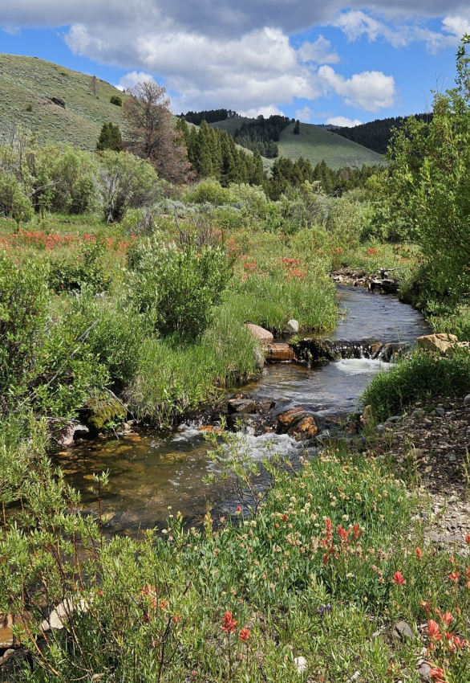
Fund Our Birch Creek Beaver Dam Analog Proposal
Requesting support to construct four BDAs on Birch Creek's first-order tributaries, using on-site materials
A low-cost, low-risk pilot that cools and stabilizes flow into Big Hole Sections most vulnerable to drought and fishing closures
Benefits ranchers, anglers, and conservationists
A small investment in Birch Creek protects the entire watershed downstream, so let's plan today!
Image Source: Big Hole Watershed Committee, Summer 2025 Newsletter; https://bhwc.org/
​
Notes:
To wrap things up, we are requesting investment in our beaver dam analog project pilot, which includes building four leaky weir dams with wooden posts and woven willow supports along Birch Creek. Your support would help sustain a project that would improve wetland quality and support the aquatic ecosystem of the Big Hole Watershed for generations to come!

Slide 19

Thank You!
Questions?

Slide 20
References
Big Hole Watershed Committee. Project pages and river conditions data. bhwc.org
EARTH 450 class data, Summer 2026. Group 6 data file analyses (Unit4_DataFileAnalyses.xlsx) and Unit 3 climate dataset (SMITH_BigHole_ClimateData.xlsx).
"Maps of Land Use in the Big Hole Watershed." EARTH 450 course, PowerPoint.
Model My Watershed. Birch Creek watershed delineation. Modelmywatershed.org
Upper Missouri Headwaters Chapter, Trout Unlimited. Big Hole River conditions. uppermissouriheadwaters.org/UMHW_RiverConditions
U.S. Fish and Wildlife Service. The Beaver Restoration Guidebook, v2.02. fws.gov/sites/default/files/documents/The-Beaver-Restoration-Guidebook-v2.02.pdf

